Slide 1

How Healthy Is Your City?
Billy Fetzner
billfetzner@yahoo.com

Slide 2
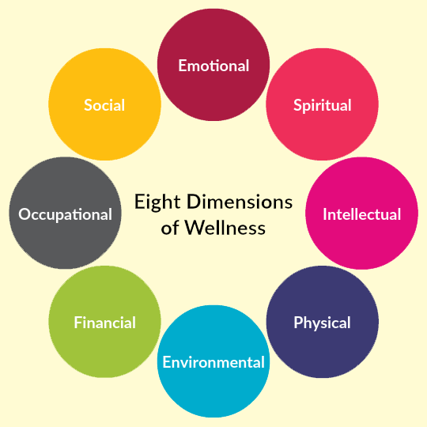
Agenda
Introduction
Importance
Data Source
Data Analysis
Machine Learning
Clustering
Classification
Conclusion/Call for Action!
This Photo by Unknown Author is licensed under CC BY-SA

Slide 3

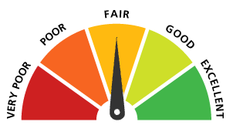
Introduction: Question
How does each city rank in terms of physical and mental health in comparison to other cities in the country?
This Photo by Unknown Author is licensed under CC BY-NC-ND

Slide 4
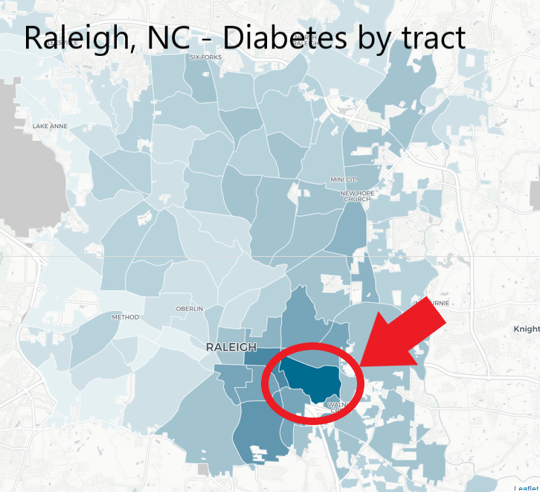
Why is this important?
Health officials
Municipalities where to focus resources
Possible Solutions:
Ranking of tracts and cities
More resources in these areas

Slide 5
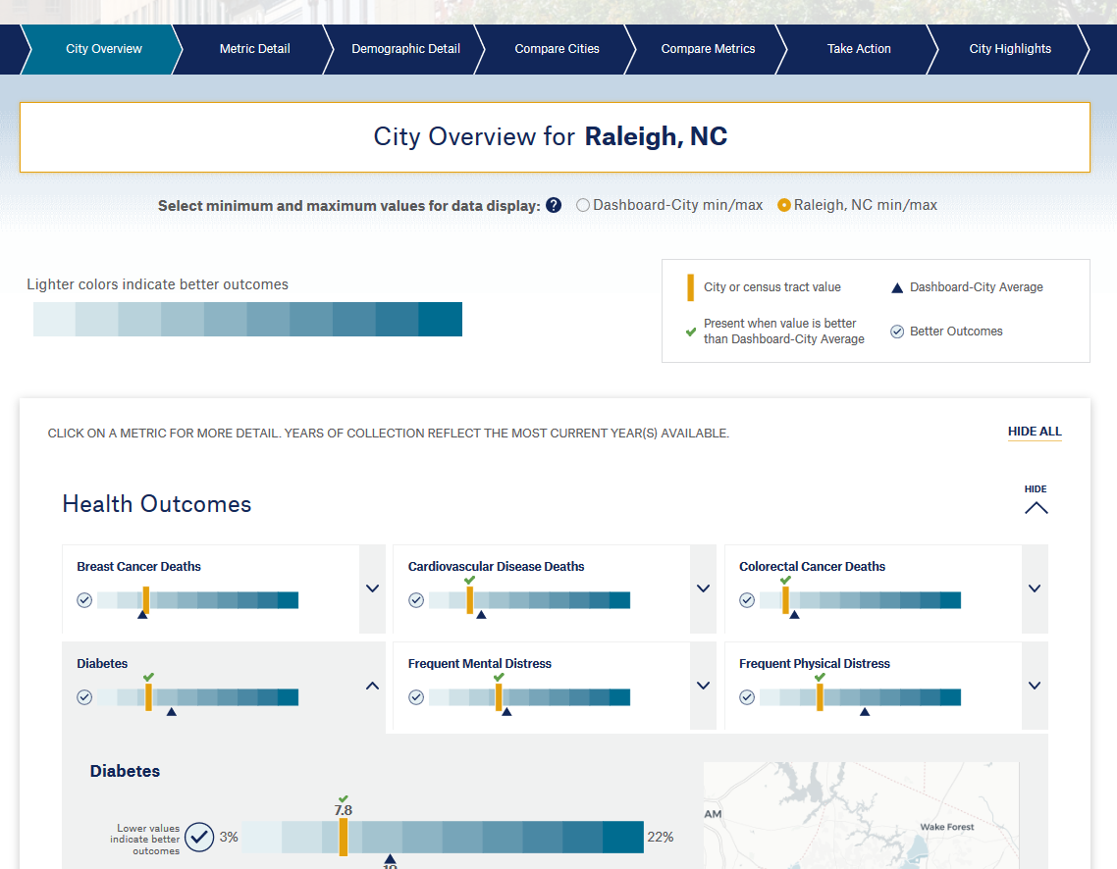
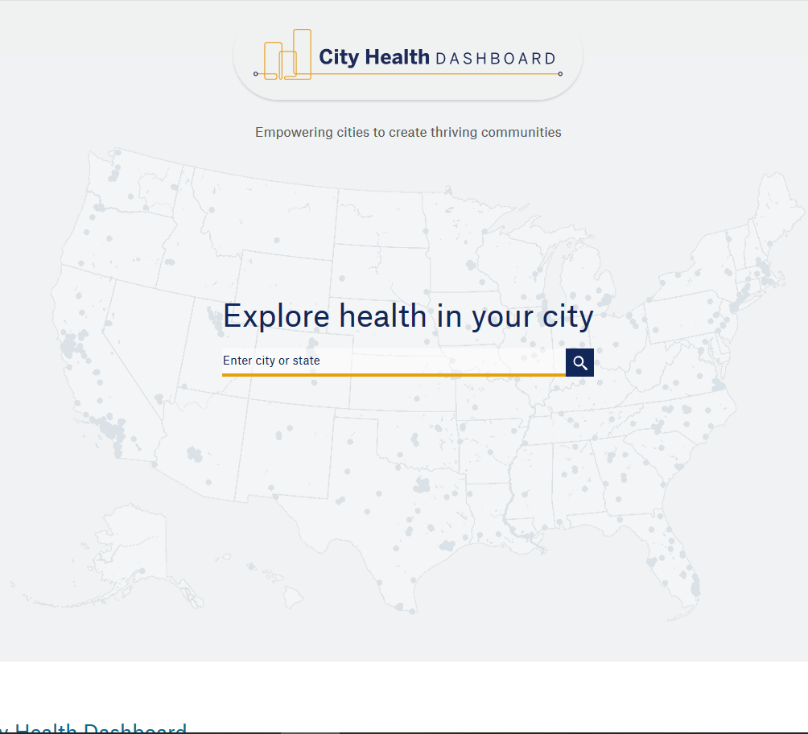
Data Source
City Health Dashboard
- City and Tract

Slide 6
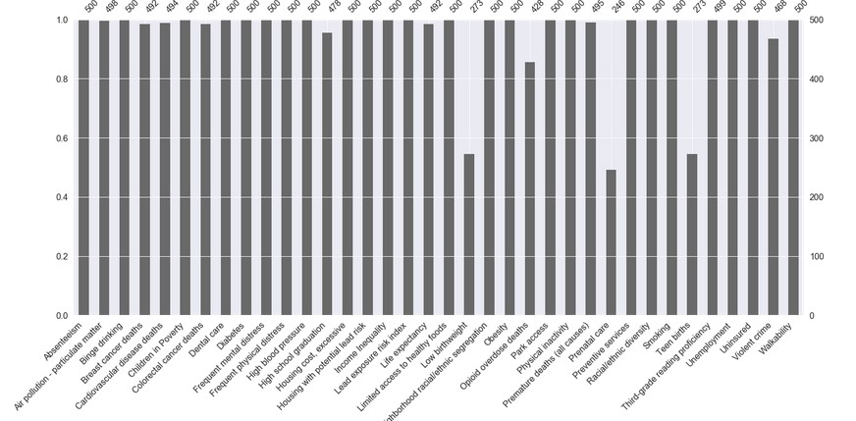
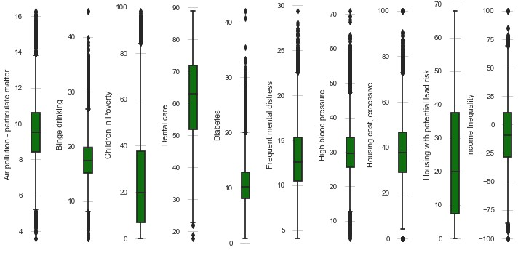
Data Analysis: Missing Data
Formatted data with metrics moved to columns
Iterative Imputer
Outliers

Slide 7
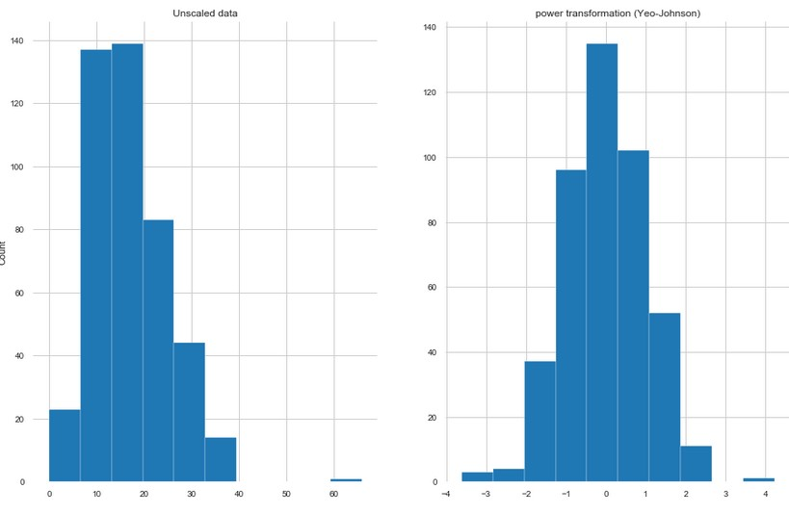
Data Analysis: Scaling
Tested for normality
Shapiro-Wilkes
D’Agostino’s
City data
Power Transformation (Yeo-Johnson)
Tract data
Quantile Transformation

Slide 8
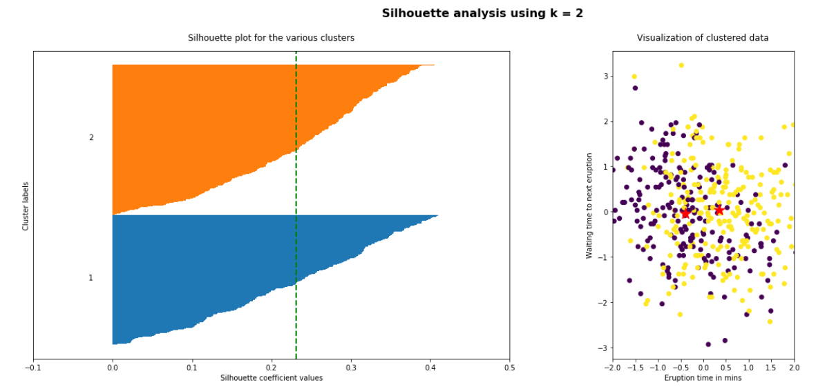
Machine Learning: Clustering
Several Clustering methods
Create clusters that classification could classify on
Best: Kmeans
Silhouette Analysis

Slide 9
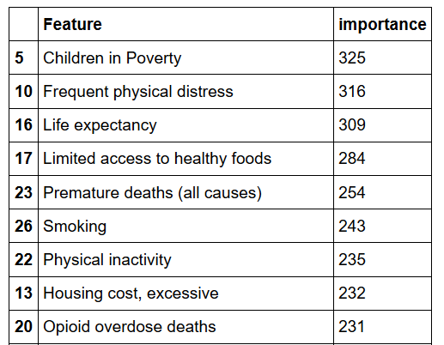
Machine Learning Classification
In conjunction with cluster labels from KMeans
Best Model: LightGBM
Gradient Boosting

Slide 10

Ranking
Scaled values
Sorted from healthiest to unhealthiest
Gave best city/tract rank of 1 -> 441 or 1 -> 26,848
Multiplied rank by feature importance as the “weight”
Resulted in a calculated score
Sorted with lowest score at the top
Gave each city/tract an overall rank based on score

Slide 11
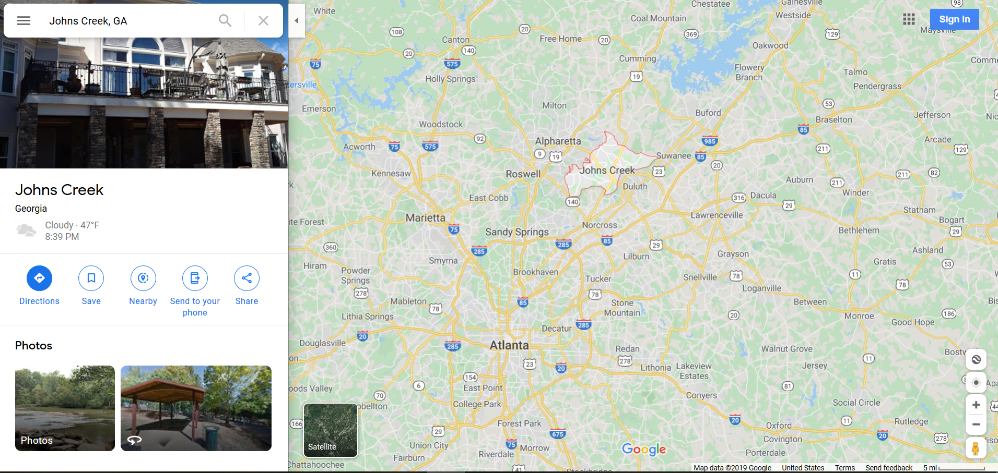
What is the Healthiest City?
John’s Creek, Georgia

Slide 12
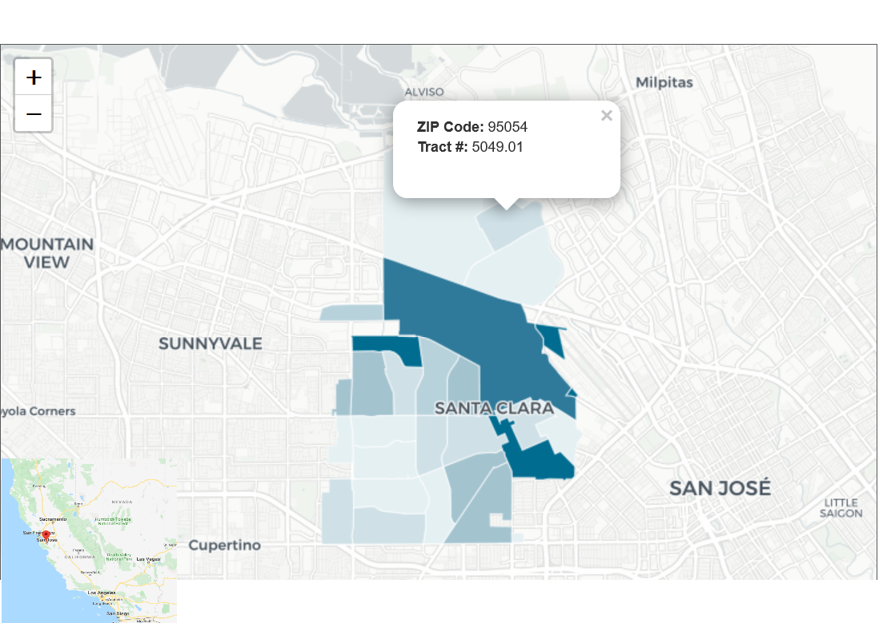
What is the Healthiest Tract?
Tract 5049.01 in Santa Clara, California

Slide 13
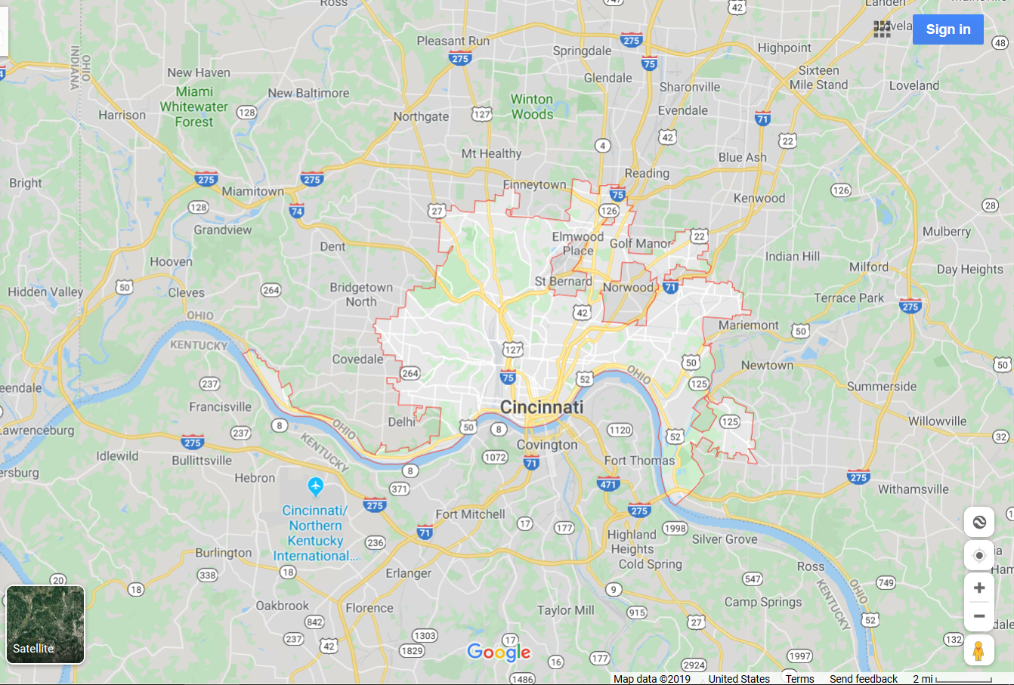
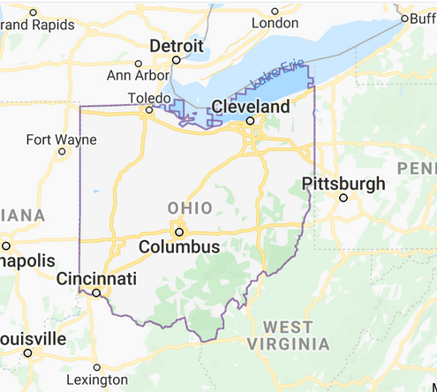
What is the Unhealthiest City?
Cincinnati, Ohio

Slide 14
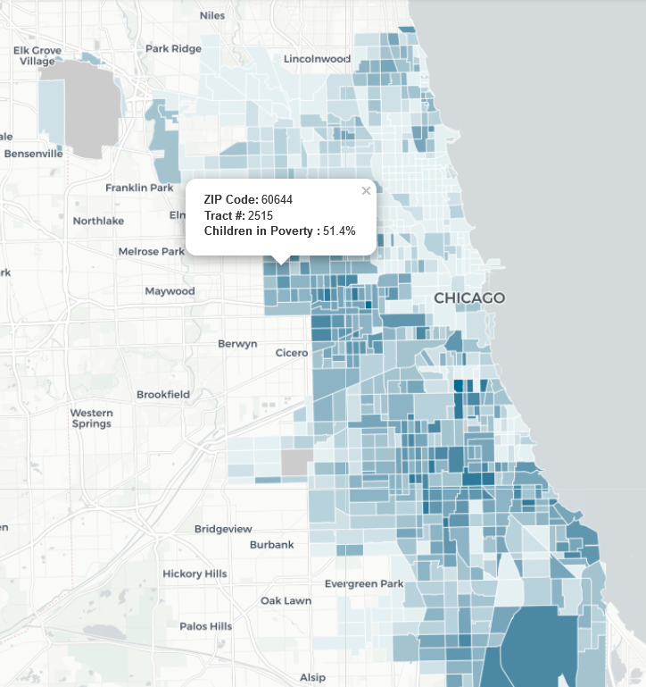
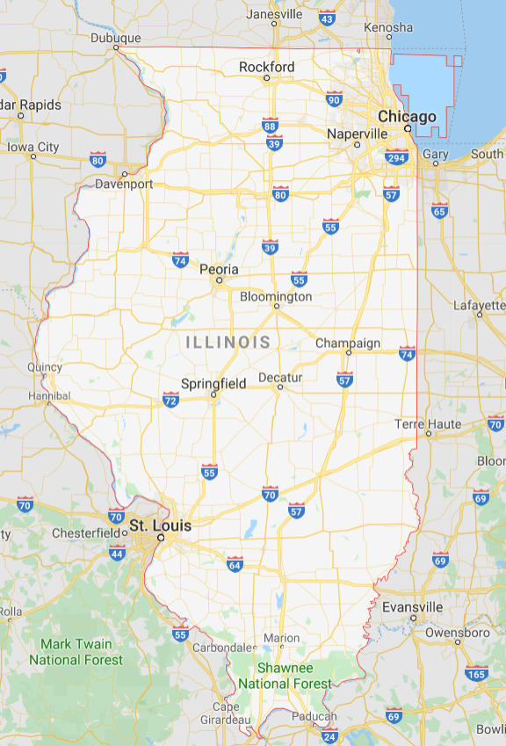
What is the Unhealthiest Tract?
Tract 2515.00 in Chicago, Illinois

Slide 15
Conclusion
Recommendations:
Find the cities that are ranked closest to your city, determine what metrics you would like to focus on, determine which cities ranked closest to your own are doing better/worse on those metrics and attempt to test out their programs
Additional research: extend to cities that are not on 500 cities dataset

Slide 16
Next Steps
Questions? – Contact me:
Billy Fetzner – billfetzner@yahoo.com
GitHub:
https://github.com/lilfetz22/Health_Scores_CAP2
Future Steps:
Machine learning that can take the demographics of any city, compare it to the cities in the 500 cities dataset, and determine the rank and health score of that city or census tract

Slide 17
Works Cited
City Health Dashboard
https://www.cityhealthdashboard.com/
CDC 500 Cities project
https://www.cdc.gov/500cities/index.htm
https://imaddabbura.github.io/post/kmeans-clustering/
https://github.com/Microsoft/LightGBM
https://www.analyticsvidhya.com/blog/2019/05/beginners-guide-hierarchical-clustering/
https://www.learndatasci.com/tutorials/k-means-clustering-algorithms-python-intro/
https://www.geeksforgeeks.org/clustering-in-machine-learning/

